Slide 1
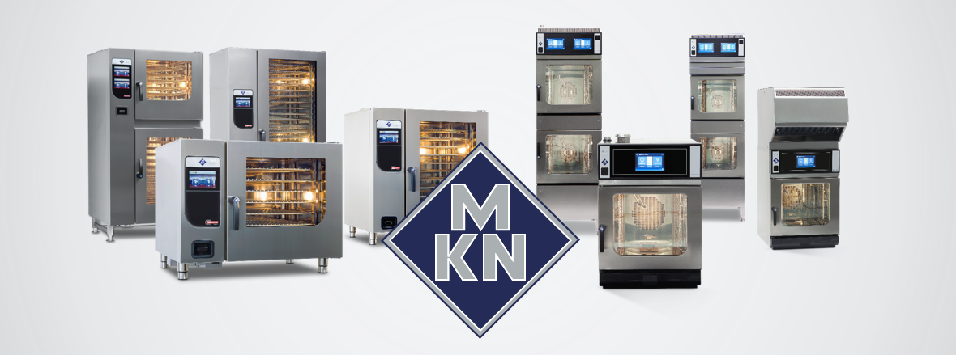
MKN Combi Ovens Outstandingly Different

Slide 2
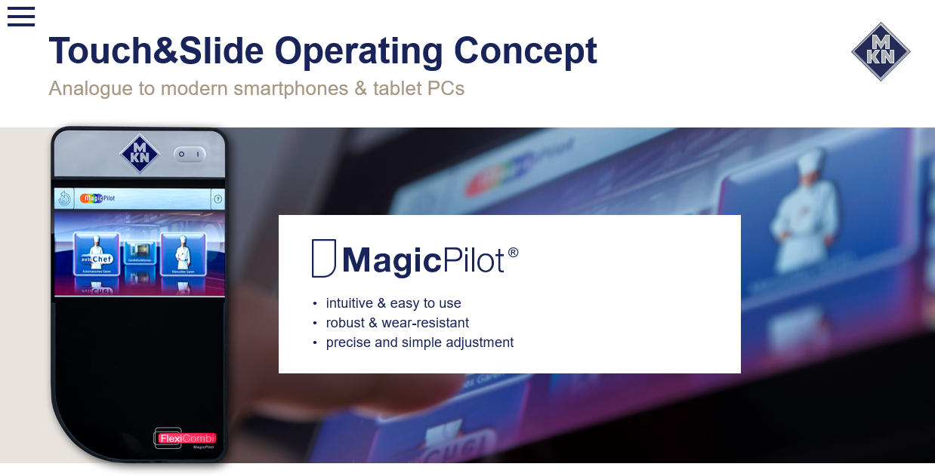

Slide 3
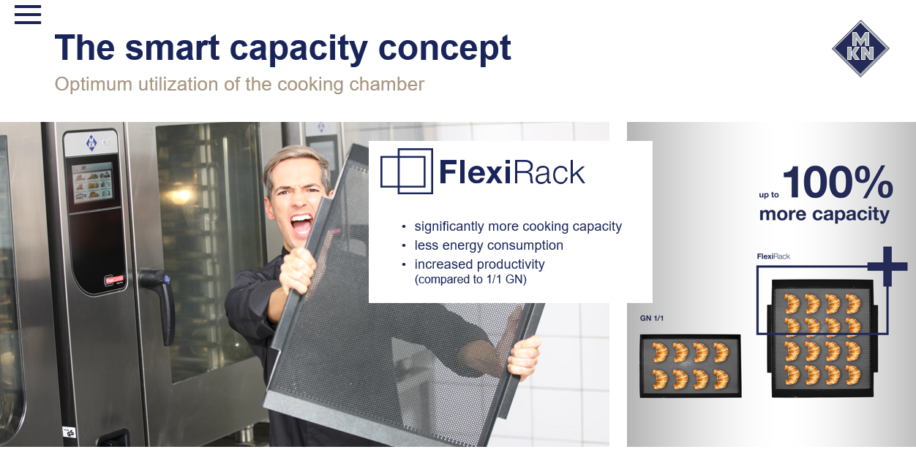

Slide 4
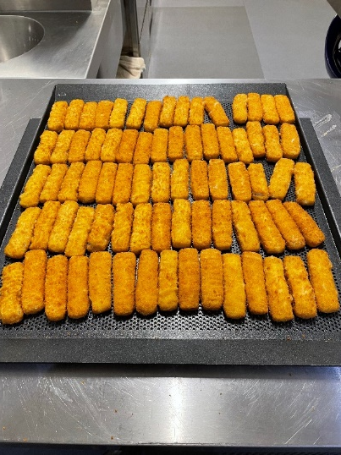
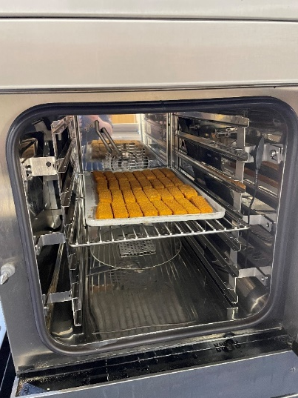
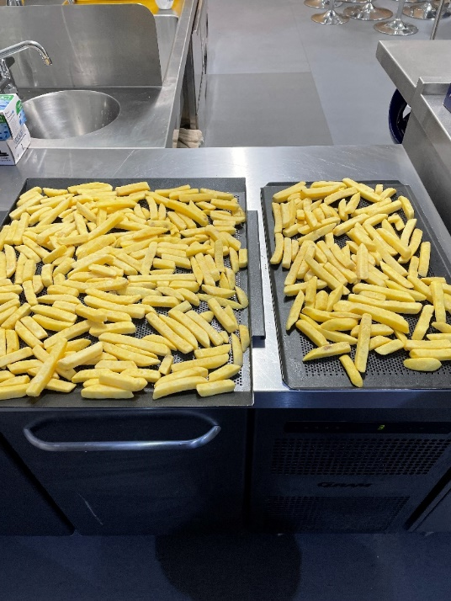
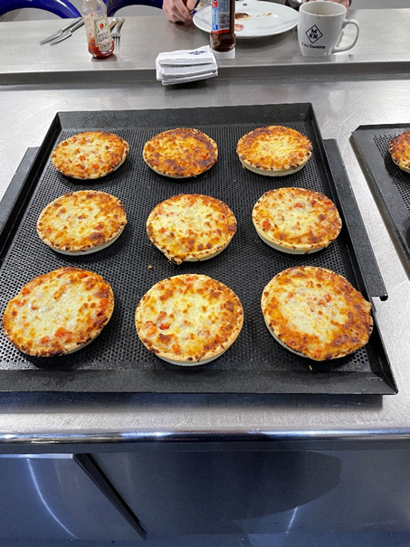
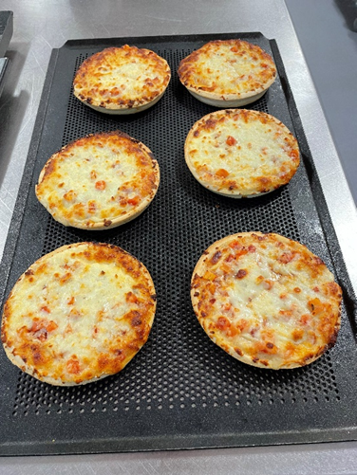

Flexi Rack vs Standard GN 1/1
Chips
FlexiRack -2.3kg
1/1 GN – 1kg
130% More Capacity per Shelf!!!
Fish Fingers
FlexiRack 75
GN 1/1 40
87.5 % More!!!
Mini Pizza’s
FlexiRack 9
GN 1/1 6
50% More!!!

Slide 5


Slide 6
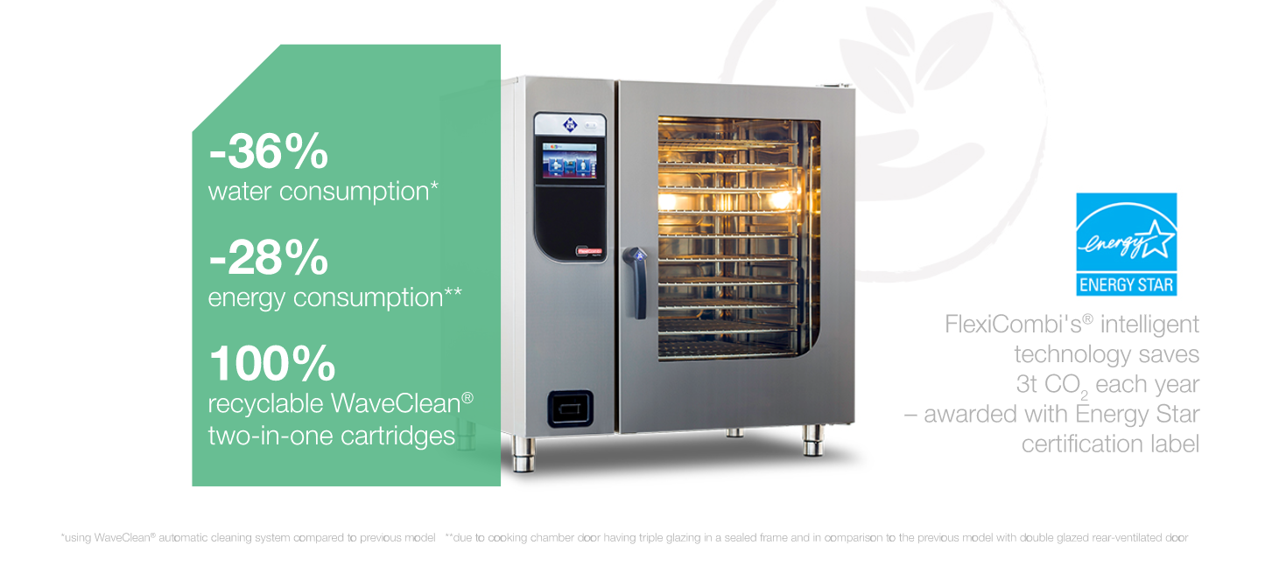

Slide 7


